Slide 1
The World's Best UI Component Suite for Building Powerful Web, Desktop and Mobile Apps
Priyadharshini K

Slide 2
Most Popular Components of Syncfusion :
DataGrid
Charts
ListView
Scheduler
Diagram
PDF Viewer
Excel Library

Slide 3
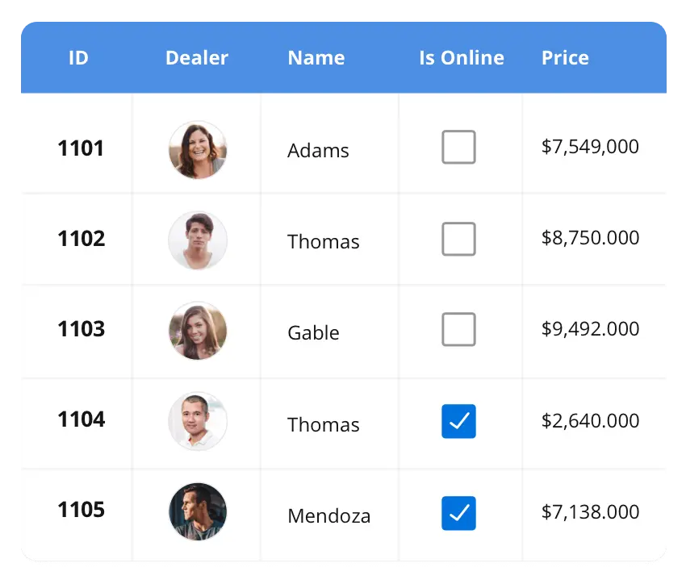

DATAGRID:
The DataGrid control is a high-performance grid component that helps display and manipulate large amounts of data in a tabular format. Its rich feature set includes functionalities like data binding, sorting, grouping, editing, filtering, swiping, dragging, resizing, loading more items, pull-to-refresh, and exporting to Excel and PDF file formats.
SUPPORTED PLATFORMS:
JavaScript Angular React Vue Blazor
Flutter ASP.NET MVC ASP.NET Core
WinForms WPF Win UI Flutter Xamarin
UWP .NET MAUI
Xamarin Flutter UWP JavaScript .NET MAUI

Slide 4
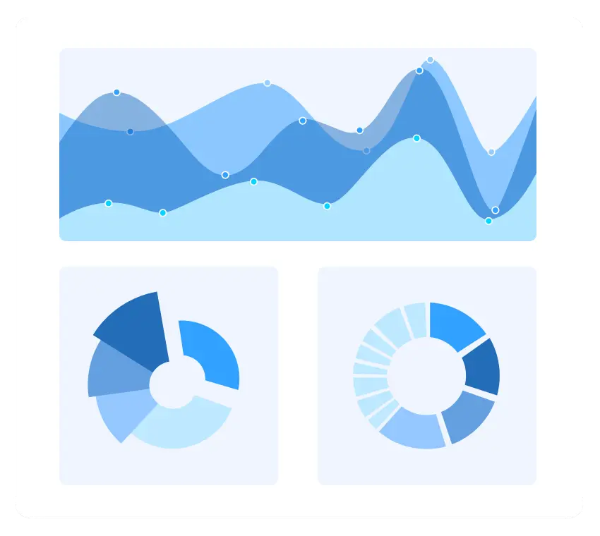

CHARTS:
The Charts control can plot a wide range of chart types, ranging from line charts to
specialized financial charts. Its rich feature set includes functionalities like data binding,
multiple axes, legends, animation, data labels, annotations, trackballs, tooltips, and
zooming.
SUPPORTED PLATFORMS:
JavaScript Angular React Vue Blazor
Flutter ASP.NET MVC ASP.NET Core
WinForms WPF Win UI Flutter Xamarin
UWP .NET MAUI
Xamarin Flutter UWP JavaScript .NET MAUI

Slide 5
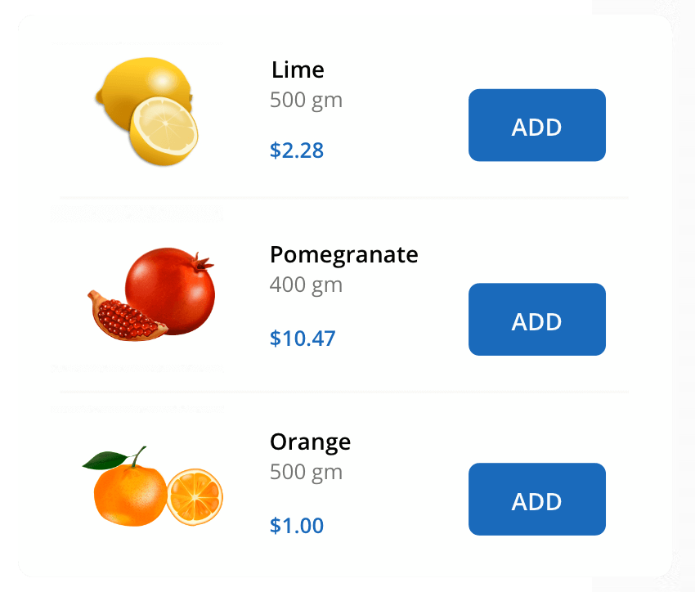
ListView:
The ListView renders a set of data items with UI views or custom templates. It has many features like grouping, sorting, filtering, paging, swiping, multiple selection, drag and drop, and different layout types. The ListView control has been optimized to work with large amounts of data.
SUPPORTED PLATFORMS:
JavaScript Angular React Vue Blazor
Flutter ASP.NET MVC ASP.NET Core
WinForms WPF Win UI Flutter Xamarin
UWP .NET MAUI
Xamarin Flutter UWP JavaScript .NET MAUI

